Slide 1
CT4029 Principles of Programming Day 4 – Session 8 Data Analysis in Python: Data Frames

Slide 2
Learning Outcomes
Overview of Python Libraries for Data Scientists
Reading Data
Selecting and Filtering the Data
Data Manipulation
Sorting
Grouping
Rearranging

Slide 3
Today’s Agenda!
Python libraries for data analysis: Pandas
Data frames creation, attributes and methods
Data frames grouping, slicing and sorting
Missing values (NaN)

Slide 4
Python libraries for data analysis: Pandas

Slide 5
Python Libraries for Data Science (1/7)
Many popular Python toolboxes/libraries:
NumPy
SciPy
Pandas
SciKit-Learn
Visualization libraries:
matplotlib
Seaborn

Slide 6
Python Libraries for Data Science (2/7)
NumPy:
Introduces objects for multidimensional arrays and matrices, as well as functions that allow to easily perform advanced mathematical and statistical operations on those objects
Provides vectorization of mathematical operations on arrays and matrices which significantly improves the performance
Many other python libraries are built on NumPy
Link: http://www.numpy.org/

Slide 7
Python Libraries for Data Science (3/7)
SciPy:
Collection of algorithms for linear algebra, differential equations, numerical integration, optimization, statistics and more
Part of SciPy Stack
Built on NumPy
Link: https://www.scipy.org/scipylib/

Slide 8
Python Libraries for Data Science (4/7)
Pandas:
Adds data structures and tools designed to work with table-like data
Provides tools for data manipulation: reshaping, merging, sorting, slicing, aggregation etc.
Allows handling missing data
Link: http://pandas.pydata.org/

Slide 9
Python Libraries for Data Science (5/7)
SciKit-Learn:
Provides machine learning algorithms: classification, regression, clustering, model validation etc.
Built on NumPy, SciPy and matplotlib
Link: http://scikit-learn.org/

Slide 10
Python Libraries for Data Science (6/7)
matplotlib:
Python 2D plotting library which produces publication quality figures in a variety of hardcopy formats
A set of functionalities similar many data visualization tools
Line plots, scatter plots, barcharts, histograms, pie charts etc.
Relatively low-level; some effort needed to create advanced visualization
Link: https://matplotlib.org/

Slide 11
Python Libraries for Data Science (7/7)
Seaborn:
Based on matplotlib
Provides high level interface for drawing attractive statistical graphics
Link: https://seaborn.pydata.org/

Slide 12
Installation
pip install numpy
pip install scipy
pip install pandas
pip install scikit-learn
pip install matplotlib
pip install seaborn

Slide 13
Loading Python Libraries
In [ ]:
#Import Python Libraries
import numpy as np
import scipy as sp
import pandas as pd
import matplotlib as mpl
import seaborn as sns
Our focus for today !

Slide 14
Data frames creation, attributes and methods

Slide 15
Reading data using pandas
There is a number of pandas commands to read other data formats:
pd.read_csv('myfile.csv',sheet_name='Sheet1', index_col=None, na_values=['NA'])
pd.read_stata('myfile.dta')
pd.read_sas('myfile.sas7bdat')
pd.read_hdf('myfile.h5','df')
#Read csv file
df = pd.read_excel("User_dataset.xlsx")
In [ ]:
Note: The above command has many optional arguments to fine-tune the data import process. This command loads an Excel file from a web source and stores it in variable df

Slide 16
Exploring data frames
In [3]:
#List first 5 records
df.head()
Out[3]:
 | First name | Last name | Date of Birth | Password | Shopping method | Appointment time | Next Booking
0 | Marc | Davis | 25/08/1998 | passwordMarc | in person | 9 | Yes
1 | John | Alex | 24/12/1987 | passwordJohn | in person | 10 | No
2 | Lewis | Quarter | 03/11/1996 | passwordLewis | online | 12 | No
3 | David | Flor | 09/06/2000 | passwordDavid | in person | 16 | NaN
4 | Suman | Kaur | 23/08/1995 | passwordSuman | online | 9 | Yes

Slide 17
Data Frame data types (1/2)
Pandas Type | Native Python Type | Description
object | string | The most general dtype. Will be assigned to your column if column has mixed types (numbers and strings).
int64 | int | Numeric characters. 64 refers to the memory allocated to hold this character.
float64 | float | Numeric characters with decimals. If a column contains numbers and NaNs(see below), pandas will default to float64, in case your missing value has a decimal.
datetime64, timedelta[ns] | N/A (but see the datetime module in Python’s standard library) | Values meant to hold time data. Look into these for time series experiments.

Slide 18
Data Frame data types (2/2)
In [4]:
#Check a particular column type
df['Appointment_time'].dtype
Out[4]: dtype('int64')
#Check types for all the columns
df.dtypes
In [5]:
Out[5]:
First name object
Last name object
Date of Birth datetime64[ns]
Password object
Shopping method object
Appointment time int64
Next Booking object
dtype: object

Slide 19
Data Frames attributes
Python objects have attributes and methods.
df.attribute | description
dtypes | list the types of the columns
columns | list the column names
axes | list the row labels and column names
ndim | number of dimensions
size | number of elements
shape | return a tuple representing the dimensionality
values | numpy representation of the data

Slide 20
Data Frames methods
Unlike attributes, python methods have parenthesis.
All attributes and methods can be listed with a dir() function: dir(df)
df.method() | description
head( [n] ), tail( [n] ) | first/last n rows
describe() | generate descriptive statistics (for numeric columns only)
max(), min() | return max/min values for all numeric columns
mean(), median() | return mean/median values for all numeric columns
std() | standard deviation
sample([n]) | returns a random sample of the data frame
dropna() | drop all the records with missing values

Slide 21
Data frames grouping, slicing and sorting

Slide 22
Selecting a column in a Data Frame
Out[6]:
0 Yes
1 No
2 No
3 NaN
4 Yes
5 NaN
6 NaN
7 No
8 No
9 Yes
Name: Next_Booking, dtype: object
Method 1: Subset the data frame using column name:
df['Next_Booking']
Method 2: Use the column name as an attribute:
df.Next_Booking
Note: there is an attribute rank for pandas data frames, so to select a column with a name
"rank" we should use method 1.
In [6]:
In [6]:

Slide 23
Data Frames groupby method
Using "group by" method we can:
Split the data into groups based on some criteria
Calculate statistics (or apply a function) to each group
In [7]:
#Group data using Shopping method
df_time_ = df.groupby(['Shopping_method'])
In [8]:
#Calculate mean value for each numeric column per each group
df_time.mean()
 | Appointment_time
Shopping_method
in person | 13.0
online | 14.4
Out[8]:

Slide 24
Data Frames groupby method
Once groupby object is create we can calculate various statistics for each group:
#Calculate mean Last name for each group:
df_time2=df.groupby('Shopping_method')[['Last_name']].mean()
Out[9]:
Empty DataFrame
Columns: []
Index: [in person, online]
In [9]:
#Calculate mean appointment time for each group:
df_time2=df.groupby('Shopping_method')[['Appointment_time']].mean()
In [10]:
Out[10]:
 | Appointment_time
Shopping_method
in person | 13.0
online | 14.4
Note: If single brackets are used to specify the column (e.g. Appointment_time), then the output is Pandas Series object. When double brackets are used the output is a Data Frame
df_time2=df.groupby('Shopping_method')['Appointment_time'].mean()

Slide 25
Data Frames groupby method
Out[11]:
grade
rank
A 83.0
B 63.0
F 16.5
D 40.0
C 52.5
groupby performance notes:
No grouping/splitting occurs until it's needed. Creating the groupby object only verifies that you have passed a valid mapping.
By default the group keys are sorted during the groupby operation. You may want to pass sort=False for potential speedup:
Out[12]:
grade
rank
A 83.0
B 63.0
C 52.5
D 40.0
F 16.5
In [11]:
#Calculate mean salary for each professor rank:
df.groupby(['rank'], sort=False)[['grade']].mean()
In [12]:
#Calculate mean salary for each professor rank:
df.groupby(['rank'], sort=True)[['grade']].mean()

Slide 26
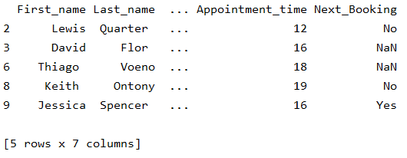
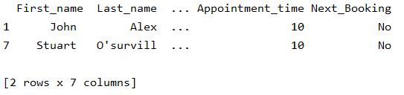
Data Frame: filtering
Any Boolean operator can be used to subset the data:
> greater; >= greater or equal;
< less; <= less or equal;
== equal; != not equal;
To subset the data we can apply Boolean indexing. This indexing is commonly known as a filter. For example if we want to subset the rows in which the appointment time is after 11 am:
Out[13]:
In [13]:
#Select Users with appointment time after 11am:
df_sub = df[df['Appointment_time'] > 11]
Out[14]:
In [14]:
#Select only those users who have an appointment at 10 am:
df_f = df[ df['Appointment_time'] == 10 ]

Slide 27
Data Frames: Slicing (1/2)
There are a number of ways to subset the Data Frame:
One or more columns
One or more rows
A subset of rows and columns
Rows and columns can be selected by their position or label

Slide 28
Data Frames: Slicing (2/2)
When selecting one column, it is possible to use single set of brackets, but the resulting object will be a Series (not a DataFrame):
In [14]:
#Select column password:
df['Password']
When we need to select more than one column and/or make the output to be a DataFrame, we should use double brackets:
In [15]:
#Select column password:
df[['Password']]

Slide 29
Data Frames: Selecting rows
If we need to select a range of rows, we can specify the range using ":"
#Select rows by their position:
df[3:9]
In [16]:
Notice that the first row has a position 0, and the last value in the range is omitted:
So for 0:10 range the first 10 rows are returned with the positions starting with 0 and ending with 9

Slide 30
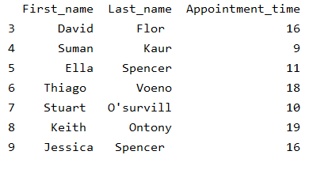
Data Frames: method loc
If we need to select a range of rows, using their labels we can use method loc:
#Select rows by their labels:
df.loc[3:9,['First_name', 'Last_name', 'Appointment_time']]
In [17]:
Out[17]:

Slide 31
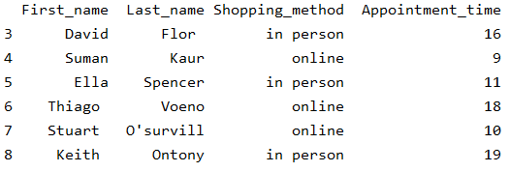
Data Frames: method iloc
If we need to select a range of rows and/or columns, using their positions we can use method iloc:
#Select rows by their labels:
df.iloc[3:9,[0, 1, 4, 5]]
In [18]:
Out[18]:

Slide 32
Data Frames: method iloc (summary)
df.iloc[0] # First row of a data frame
df.iloc[i] #(i+1)th row
df.iloc[-1] # Last row
df.iloc[:, 0] # First column
df.iloc[:, -1] # Last column
df.iloc[0:7] #First 7 rows
df.iloc[:, 0:2] #First 2 columns
df.iloc[1:3, 0:2] #Second through third rows and first 2 columns
df.iloc[[0,5], [1,3]] #1st and 6th rows and 2nd and 4th columns

Slide 33
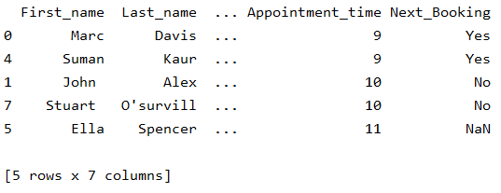
Data Frames: Sorting (1/2)
We can sort the data by a value in the column. By default the sorting will occur in ascending order and a new data frame is return
# Create a new data frame from the original sorted by the column Salary
df_sorted = df.sort_values( by ='Appointment_time')
df_sorted.head()
In [19]:
Out[19]:

Slide 34
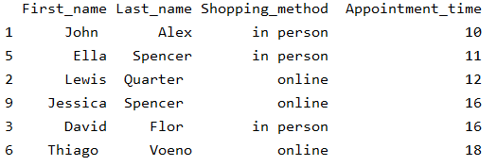
Data Frames: Sorting (2/2)
We can sort the data using 2 or more columns:
In [20]:
df_sorted = df.sort_values( by =['Appointment_time', 'Shopping_method'], ascending = [True, False])
df_sorted.iloc[3:9,[0,1,4,5]].head(10)
Out[20]:

Slide 35
Missing Values

Slide 36
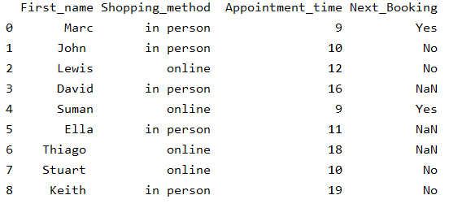
Missing Values (1/3)
Missing values are marked as NaN
# Read a dataset with missing values
df_NaN= df.iloc[0:9,[0,4,5,6]]
In [21]:
Out[21]:

Slide 37
Missing Values (2/3)
There are a number of methods to deal with missing values in the data frame:
df.method() | description
dropna() | Drop missing observations
dropna(how='all') | Drop observations where all cells is NA
dropna(axis=1, how='all') | Drop column if all the values are missing
dropna(thresh = 5) | Drop rows that contain less than 5 non-missing values
fillna(0) | Replace missing values with zeros
isnull() | returns True if the value is missing
notnull() | Returns True for non-missing values

Slide 38
Missing Values (3/3)
When summing the data, missing values will be treated as zero
If all values are missing, the sum will be equal to NaN
cumsum() and cumprod() methods ignore missing values but preserve them in the resulting arrays
Missing values in GroupBy method are excluded
Many descriptive statistics methods have skipna option to control if missing data should be excluded . This value is set to True by default

Slide 39
Aggregation Functions in Pandas (1/2)
Aggregation - computing a summary statistic about each group, i.e.
compute group sums or means
compute group sizes/counts
Common aggregation functions:
min, max
count, sum, prod
mean, median, mode, mad
std, var

Slide 40
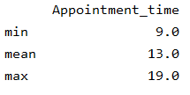
Aggregation Functions in Pandas (2/2)
In [22]:
df[['Appointment_time']].agg(['min','mean','max'])
Out[22]:
agg() method are useful when multiple statistics are computed per column.

Slide 41
Basic Descriptive Statistics
df.method() | description
describe | Basic statistics (count, mean, std, min, quantiles, max)
min, max | Minimum and maximum values
mean, median, mode | Arithmetic average, median and mode
var, std | Variance and standard deviation
sem | Standard error of mean
skew | Sample skewness
kurt | kurtosis

Slide 42
Next Session!
Numpy Arrays
Data Visualization through Matplotlib

